Slide 1
Hello and welcome to
Virtual Future Heroes Ambulance session we will begin shortly.
Please mute your mics and switch off your cameras.
If you need technical assistance please use the chat box and we will be happy to help.

Slide 2
House Keeping Rules
Please mute your microphone and turn off your cameras. This will help us manage background noise during the presentations.
Please do not take any recordings or screen shots of the screen during the session
If you need any technical help during the event please message us using the chat box.
If you would like to ask a question please use the chat box. We will try to answer as many questions as possible at the end of the session and any we do not get to we will follow-up afterwards.
The session will be not be recorded live but we will be uploading the presentations to the Extra Heroes webpage after this session.
Please bear with us if there are technical issues we will resolve them as quickly as possible. You may find that some of the videos we play may buffer, we will share the links after the event for anyone who had any issues watching them.
Social media – please tag us in @hwe_academy and #Future Heroes
Most importantly – please join in with the quizzes and activities
Your feedback is important to use please feel free to email us – academy.hwe@nhs.net

Slide 3
Ambulance Service Careers
Notes:
Front screen to have on at the start of presentation

Slide 4
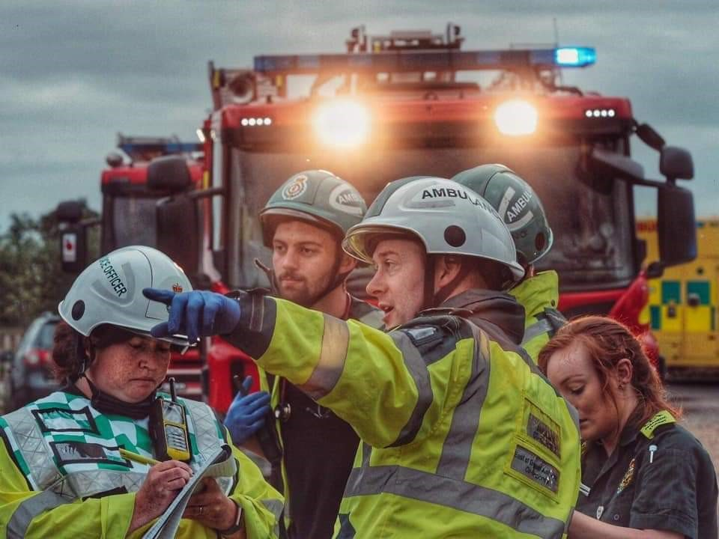
Introduction
Who’s who today
Facility and safety brief
Our promise to you
Be a good employer
Be fair and open
Provide opportunities to develop your skills and career
Listen to your concerns and ideas
Virtual delivery etiquette
Notes:
Introduce yourself and any supporting speakers. If delivered virtually – run through etiquette (mute, videos off, hands raised or chat use, respect others)

Slide 5
Why the ?
Britain’s single biggest employer (1.4 million)
350 careers. One NHS. Your future
Clinical and non-clinical careers
Long term job stability
Holiday entitlement
National NHS pension scheme
Career progression
Access to health service discounts
6 Cs – to our staff and our patients
https://www.youtube.com/watch?v=wZXm9H-lHH8 (2 min)
Notes:
6 Cs – Commitment, Care, Compassion, Competence, Communication and Courage

Slide 6
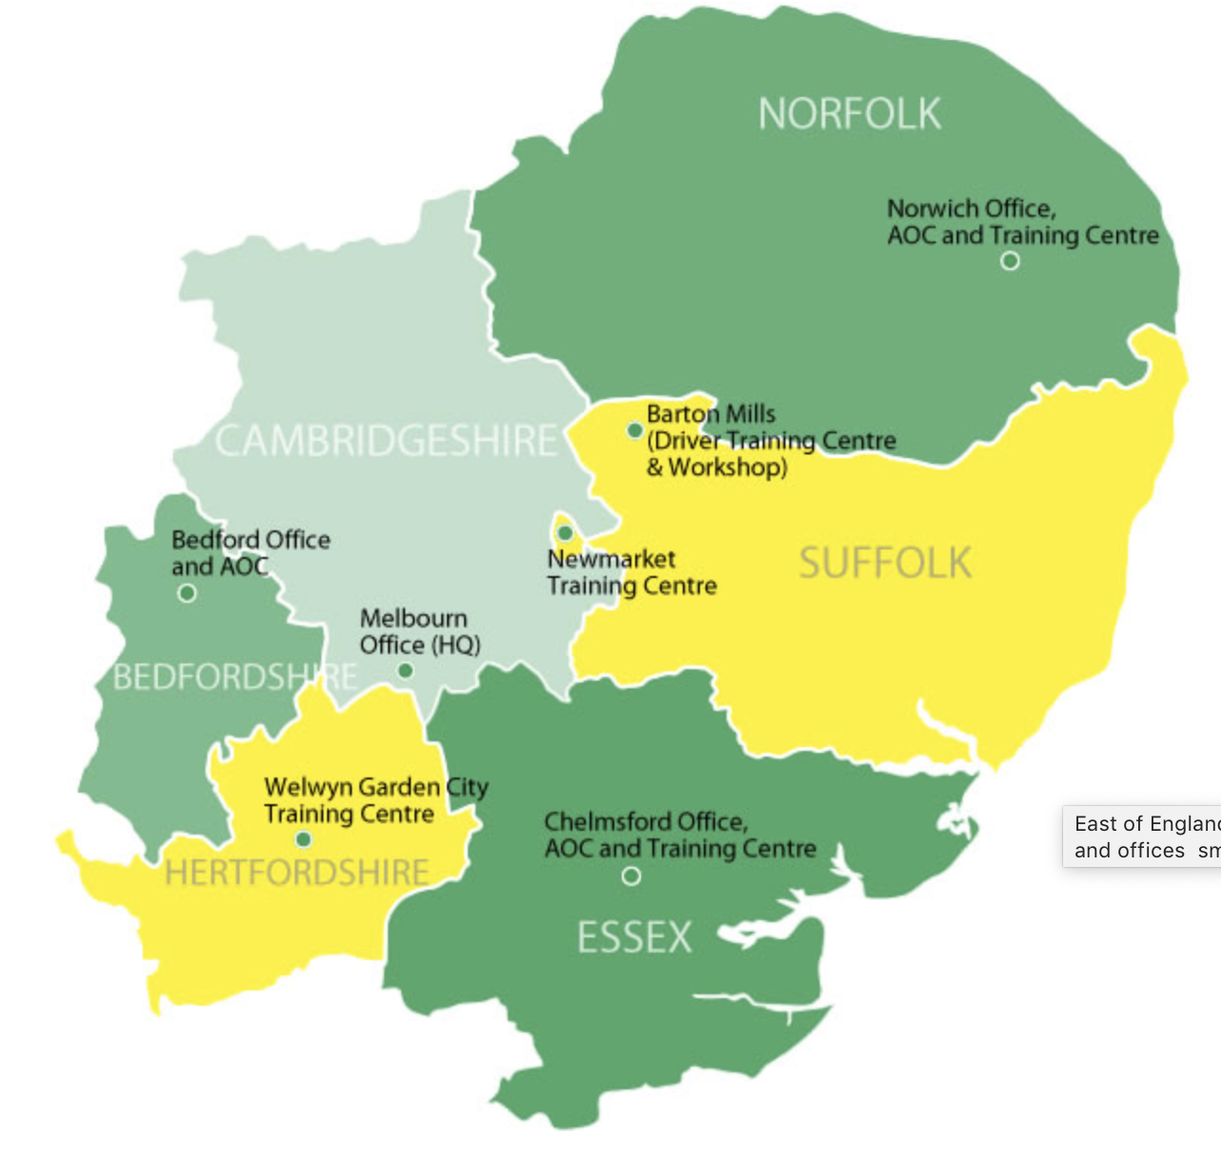
We are a BIG organisation
More than 5,000 staff and volunteers cover 7,500 square miles
There are potentially more than six million patients….
We handle more than one million 999 calls every year, over 2,500 calls a day
We drive a fleet of 1,000+ vehicles
Work with 17 acute trusts (A&Es)
Over 100 ambulance stations and
3 Operations Centres
Budget of £281 million
Notes:
Over 4,000 staff with a further 1,000+ volunteers
Three control rooms. 4 Training & Education Centres. Driver Training centre in Suffolk
Fleet includes ambulances, manager’s response cars, rapid response cars, Patient Transport Service and support staff vehicles.
The EEAST Patient Transport Service accounts for around 1.5 million patient journeys to and from Hospital. The equates to a further 175 vehicles in our fleet.
EEAST Feeds into 17 Acute Trusts with A&E and we have one Major Trauma Centre in Cambridge, although we do have access to those outside of the East of England such as London MTCs.

Slide 7
We are a BIG organisation
Berkhamsted to Waveney 150 miles
Thurrock to Cromer 130 miles
Peterborough to Felixstowe 100 miles

Slide 8
Our values
Care
We value warmth empathy and compassion in all our relationships
Teamwork
Together as one, we work with pride and commitment to achieve our vision
Quality
We strive to consistently achieve high standards through continuous improvement
Respect
We value individuals, including our patients, our staff and our partners in every interaction
Honesty
We value a culture that has trust, integrity and transparency at the centre of everything we do
Notes:
The East of England Ambulance NHS Trust has five CORE VALUES which we expect all of our staff to be aware of and use in there daily life and with patients.
Care We value warmth, empathy and compassion in all our relationships
Teamwork Together as one, we work with pride and commitment to achieve our vision
Quality We strive to consistently achieve high standards through continuous improvement
Respect We value individuals, including our patients, our staff and our partners in every interaction
Honesty We value a culture that has trust, integrity and transparency at the centre of everything we do.

Slide 9
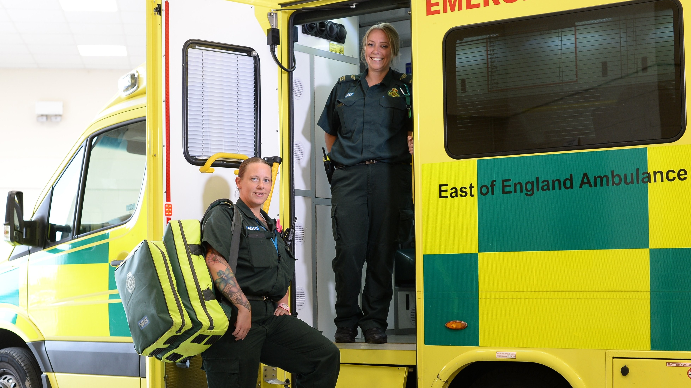
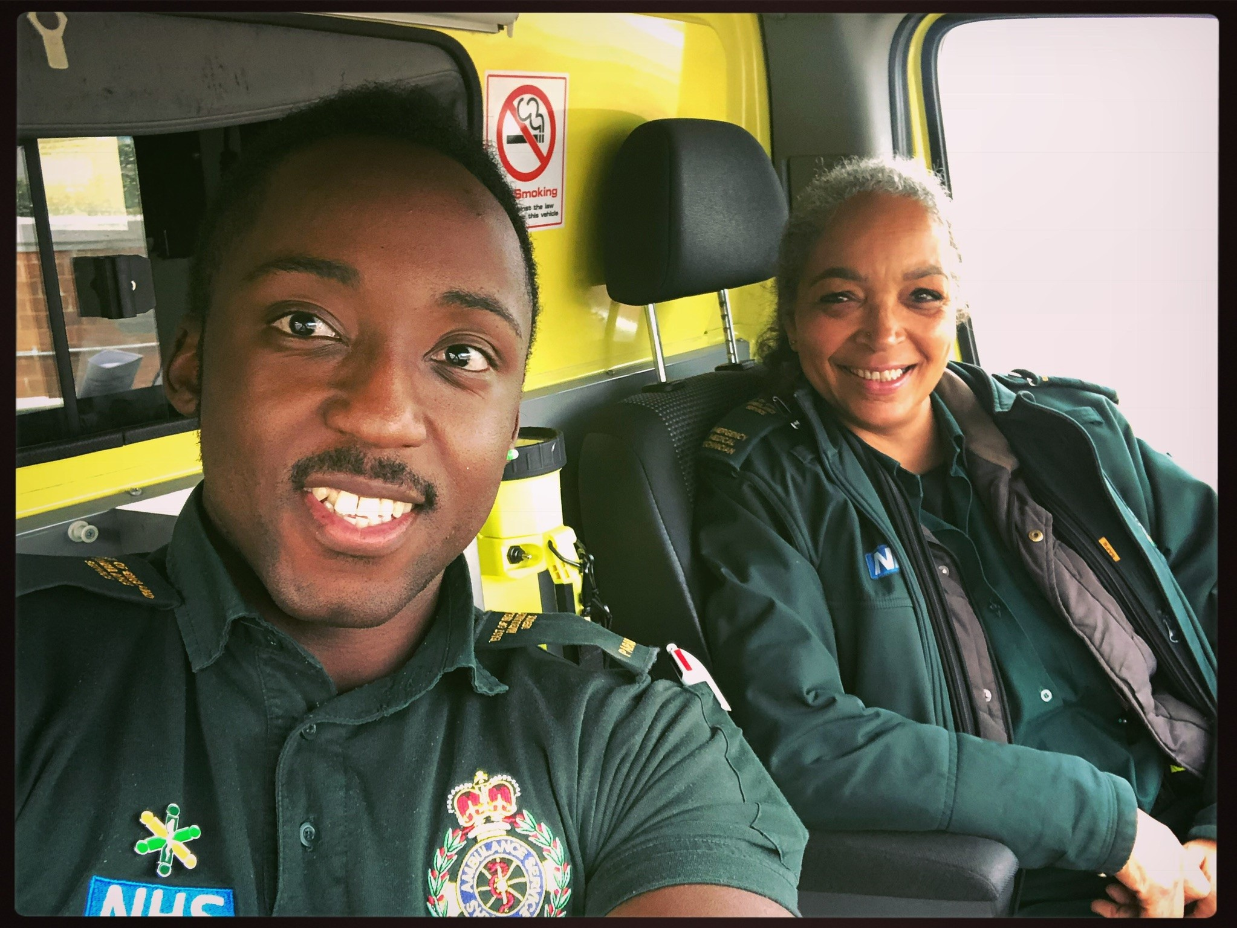
Notes:
We are committed to promoting Equality, Diversity and Human Rights to all staff and to ensure equal and fair access to our services by patients, their families and carers

Slide 10
Equality & Inclusion at EEAST
https://www.youtube.com/watch?v=TBEZHxkwCRs (3 min 9)

Slide 11
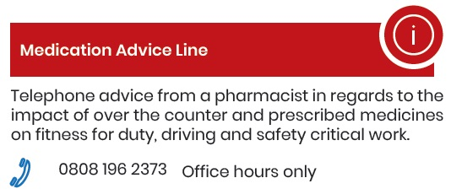
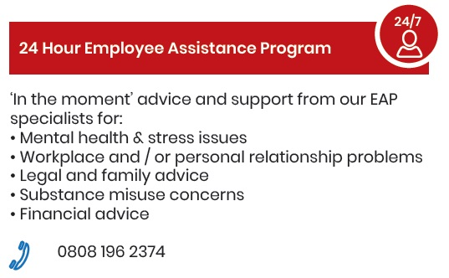
Staff support in EEAST
Occupational Health & Wellbeing services

Slide 12
Ambulance Operations Centre
3 AOCs – Bedford (Bedfordshire), Hellesdon (Norfolk), Chelmsford (Essex)
Positions in our Ambulance Operations Centre:
Emergency Call handler – Band 3, 4, 5
5 week training course
Patient Transport Dispatcher – Band 3, 4
2 week training course
Ambulance Dispatcher – Band 4, 5
2 week training course
Team Leaders + Managers – Band 5 upwards
‘Commercial Contact Centre’ staff
Administrative staff and other support staff
Training involves mentoring and assessments
in addition to above initial courses.
Unsocial hours are paid in addition to the basic salary
Notes:
Emergency call handlers deal with our 999 calls. Their role is to take essential details about the patient's condition and the exact location, logging them onto a computer system. They may have to give basic first aid advice by phone in life-threatening situations.
Call Handler (B3) – Senior Call Handler (B4), Call Handler Team Leader (B5)
Band 3 – Starting £19,737. Band 4 – Starting £21,892. Band 5 – Starting £24,907.
Criteria
Four GCSEs at grade C or above (or an equivalent qualification) including English and Maths
Good keyboard skills and use of IT such as windows based systems
Excellent listening skills
Effective verbal and written communication skills
To be able to prioritise and undertake numerous tasks simultaneously
The ability to manage and support others during times of crisis – most commonly during an emergency call.

Slide 13
Categorising our calls
Category 1 – Immediately life threatening injuries or illness. Average response time of 7 minutes
Category 2 – Emergency. Average response of 18 minutes.
Category 3 – Urgent calls. Responded to within 120 minutes.
Category 4 – Less urgent. Responded to within 180 minutes.
Category 5 – Hear & Treat. Responded to within 180 minutes.
Notes:
What kind of call would fit in to each category?
Cat1 – Cardiac arrest, traumatic serious injury, severe allergic reaction Cat2

Slide 14
Categorising our calls - Quiz
Elderly lady who has fallen without injury?
Category 3
Young child fell off his bike earlier in the day and cut his hand?
Category 4
Lying in bed barely breathing and not responding?
Category 1
6 months of back pain, slowly getting worse?
Category 5
Can’t speak properly, one side of their face suddenly isn’t moving properly and they can’t lift one of their arms?
Category 2
Notes:
What kind of call would fit in to each category?
Cat1 – Cardiac arrest, traumatic serious injury, severe allergic reaction Cat2

Slide 15
Hear & Treat (ECAT)
ECAT – Emergency Clinical & Triage
Staffed by paramedics, nurses and emergency care practitioners who make further clinical assessments for less seriously ill patients in order to establish best care for them.
Support staff then follow up and facilitate referrals etc.

Slide 16
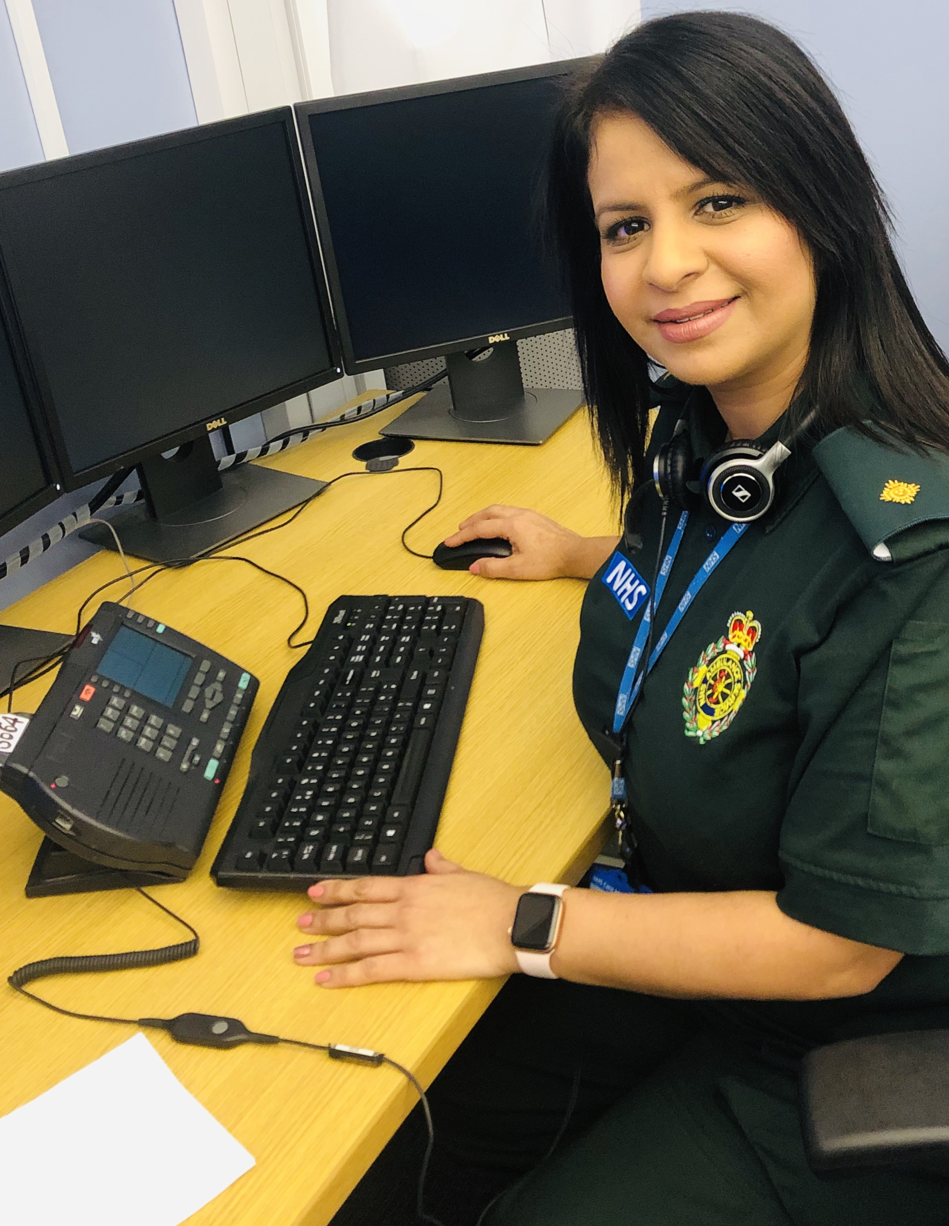
Hear & Treat (ECAT)
Think of some examples of alternative options to sending an ambulance to a patient
Family member, bus or taxi to hospital
Walk–in–Centre or Minor Injuries Unit
GP Surgery – Doctor, Nurse or HCA
Call 111 – Advice or access to community services (OOH GP, Nurse)
Visit the pharmacy
Keep and maintain a healthy medicine cabinet at home (pain relief, cough mixture, hayfever tablets)

Slide 17
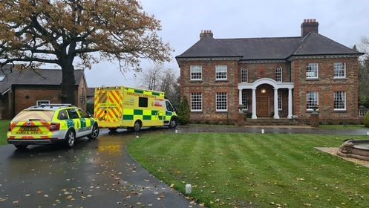
When you need an ambulance
https://www.youtube.com/watch?v=8xJEgHbe3Zc (3 min 10)

Slide 18
Clinical Recruitment
Apprentice Emergency Care Support Worker (ECSW)
12-18 month apprenticeship learning to deliver life support in A&E Operations to ECSW scope of practice. Banding: Band 3 Academic Entry Requirements: GCSE Maths and English Grade D+ or equivalent. Functional Skills Level 1 Additional Highlighted Requirements: C1 driving licence Recruitment: External - Apply via Trust vacancy page Training course: Eight weeks clinical, four weeks emergency driving
ACA Urgent Tier
Working in A&E Operations to support patient conveyance. Banding: Band 3 Academic Entry Requirements: GCSE Maths and English Grade D+ or equivalent. Functional Skills Level 1 Additional Highlighted Requirements: None Recruitment: External - Apply via Trust vacancy page Training course: Three weeks clinical, one week driving
Notes:
Pay band 3 2020/2021 £19,737 - £21,142
Plus shift allowance where applicable
Fringe of 5% in areas close to London including southern parts of Hertfordshire and Essex

Slide 19
Clinical Recruitment
Apprentice Emergency Medical Technician (EMT)
12-18 month apprenticeship learning to deliver life support in A&E Operations to EMT scope of practice. Banding: Band 4 Academic Entry Requirements: GCSE Maths and English Grade C+ or equivalent. Level 2 Functional Skills Additional Highlighted Requirements: C1 driving licence Recruitment: External - Apply via Trust vacancy page Training course: 12 weeks clinical, four weeks emergency driving
Paramedic
HCPC registered professional delivering emergency care to Paramedic/NQP scope of practice. Banding: Band 5-6 Academic Entry Requirements: HCPC registration through appropriate qualification Additional Highlighted Requirements: C1 driving licence Recruitment: External – apply via Trust vacancy page. Bank/Permanent Training course: Two week induction
3 years to achieve via University Education and job placement
Notes:
NHS pay band 2020/2021
Band 4 - £21,892 - £24,157
Band 5 - £24,907 - £30,615
Band 6 - £31,365 - £37,890
Plus shift allowance where applicable
Fringe of 5% in areas close to London including southern parts of Hertfordshire and Essex

Slide 20
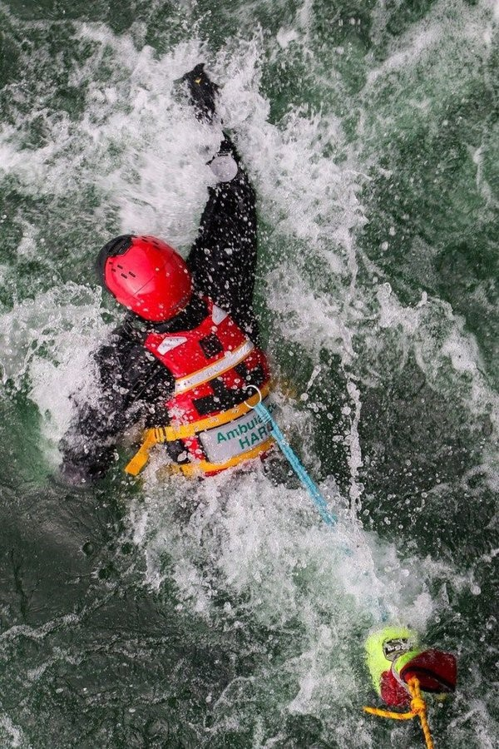
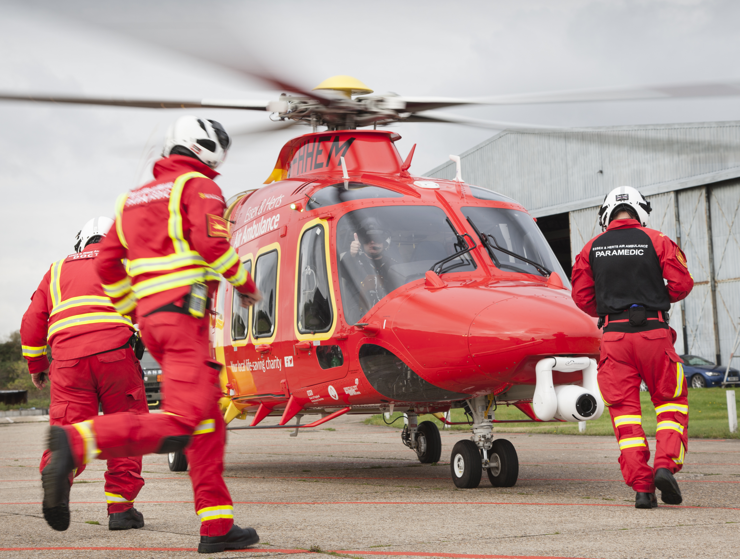
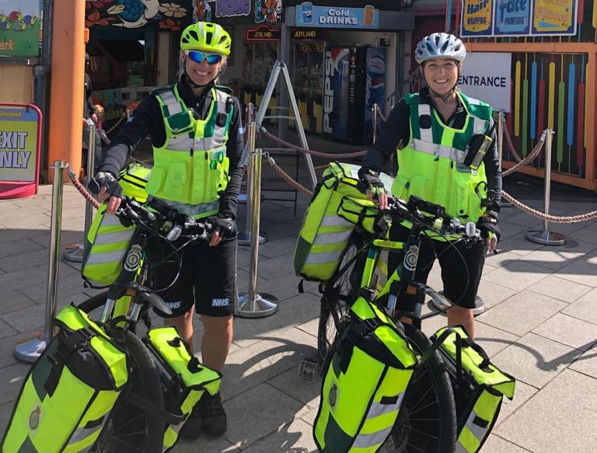
Paramedic opportunities
ECAT (previously mentioned)
Leadership & Management
Research paramedic
Training & Education
Cycle Responder in certain areas
Specialist/Advanced practice in Urgent or Critical Care
Hazardous Area Response Team

Slide 21
www.collegeofparamedics.co.uk
https://youtu.be/UzikvhXF5G0 (1 min 40) https://youtu.be/e35bKzhYMIk (4 min 20) https://youtu.be/hLbXNSaD0Ck (1 min 48)
Notes:
The College of Paramedics is the recognised professional body for all paramedics in the UK
Role is to promote and develop the paramedic profession
Over 20,000 members
Visit the website for more information on becoming a paramedic and what opportunities the role could lead to.

Slide 22
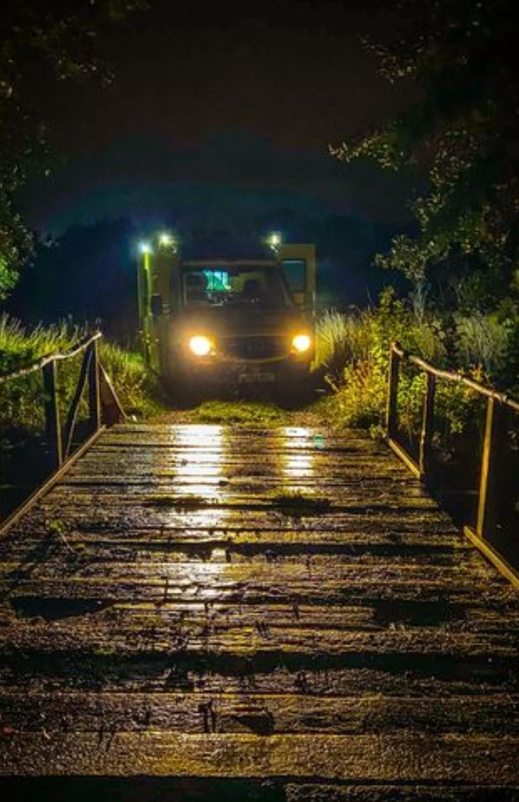
Shift work
Shifts can be very long and demanding with little opportunity to rest between incidents
You could be working days but also regularly working nights and weekends
Sometimes our staff are late home from work because an incident has taken them beyond their finish time
One break – 30 minutes but with an additional 15 minute period where you can be required to attend a more serious call
Some of our journey times are long and can be full of hazards

Slide 23
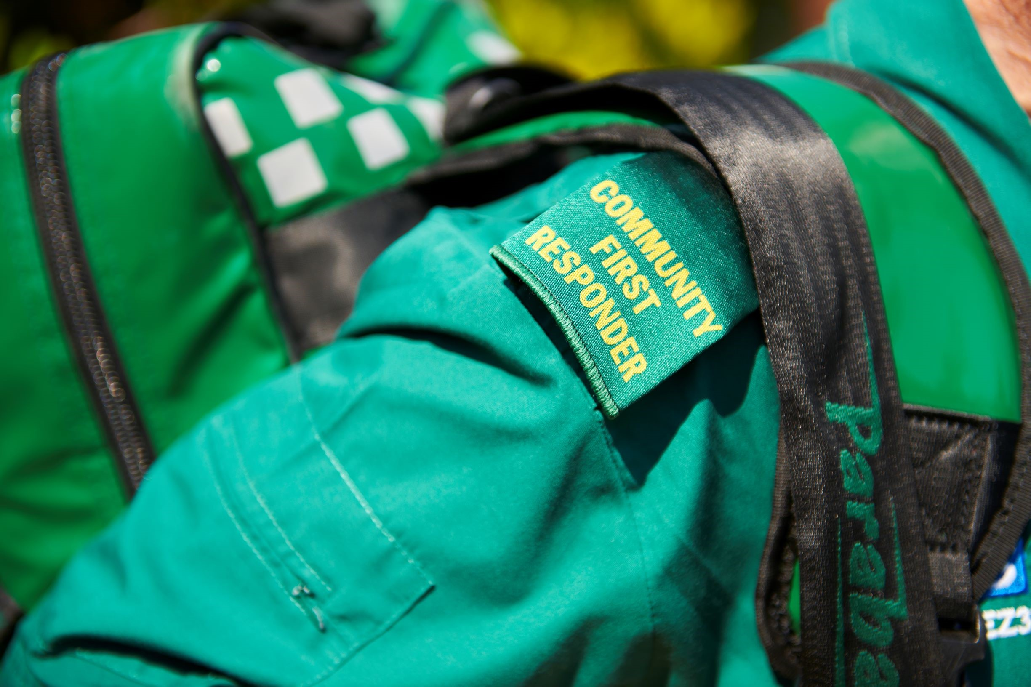
Voluntary Community First Responders (CFRs)
https://www.youtube.com/watch?v=kOISaGL9k34

Slide 24
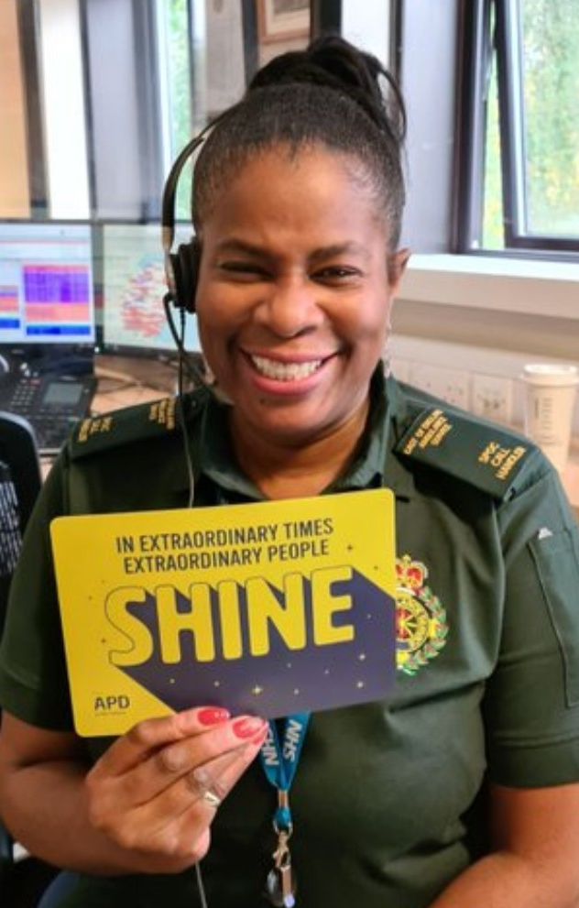
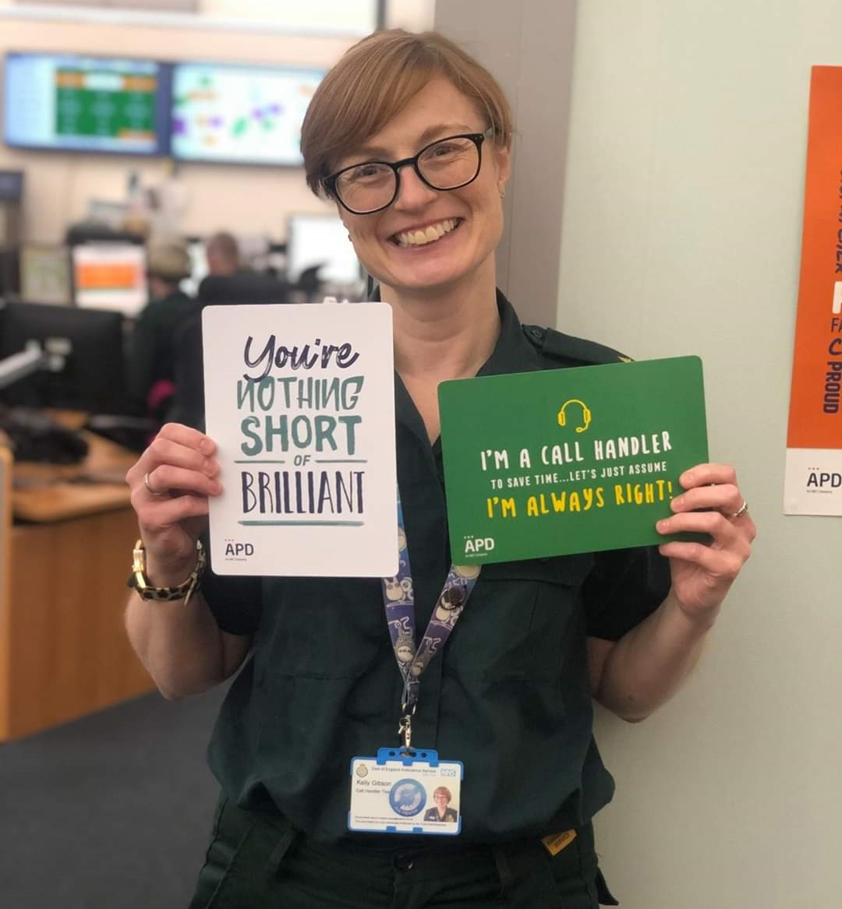
Other roles in EEAST
Patient Transport Service
(Various positions)
Workforce department (HR)
Health & Safety
Patient Experience (PALS)
Patient Safety department
Training & Education
(Clinical & Driving)

Slide 25
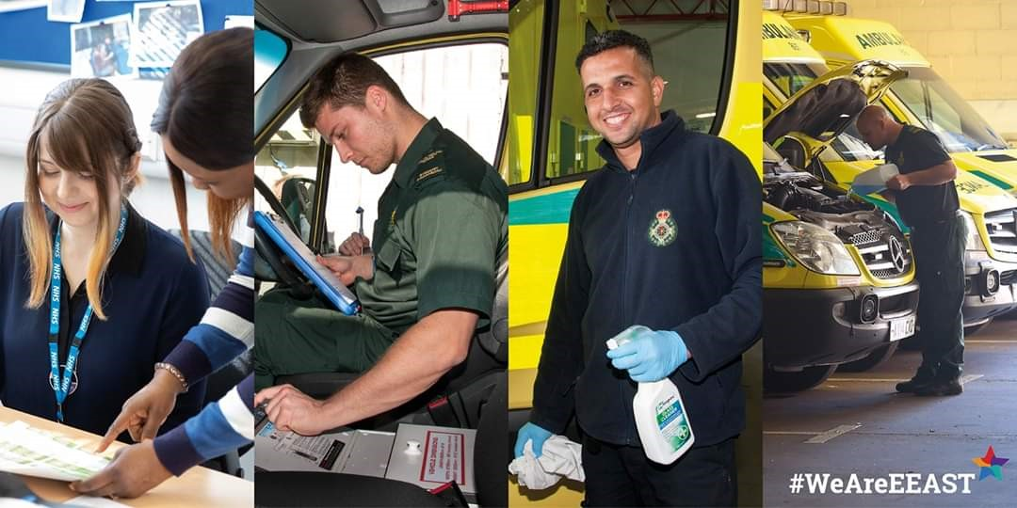
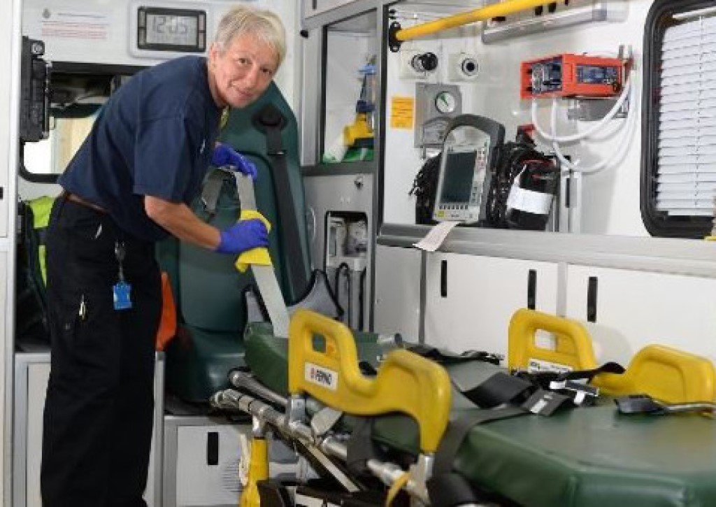
Other roles in EEAST
Finance Department and Procurement
Information Technology & Governance
Fleet mechanics, Make Ready services
Estates, Medical Devices, Administration staff

Slide 26
Any questions?
Any questions?

